Slide 1
ATL Academy
Project lombok

Slide 2
Project Lombok
Project lombok using

Slide 3
Avoid Repetitive Code
Java is a great language but it sometimes gets too verbose for things you have to do in your code for common tasks or compliancy with some framework practices. These do very often bring no real value to the business side of your programs – and this is where Lombok is here to make your life happier and yourself more productive.

Slide 4
dependency maven
<dependency>
<groupId>org.projectlombok</groupId>
<artifactId>lombok</artifactId>
<version>1.18.10</version>
<scope>provided</scope>
</dependency>

Slide 5
dependency gradle
If your gradle version is >= 2.12 you can use lombok by adding the following to your build.gradle in the dependencies block:
compileOnly "org.projectlombok:lombok:1.16.16"
If you use an older version you can still use the following:
provided "org.projectlombok:lombok:1.16.16"
as long as your gradle build include a war task (otherwise the "provided" scope is not available and you have to create your own configuration as explained here )

Slide 6
Getters/Setters, Constructors – So Repetitive
Encapsulating object properties via public getter and setter methods is such a common practice in the Java world, and lots of frameworks rely on this “Java Bean” pattern extensively: a class with an empty constructor and get/set methods for “properties”.
This is so common that most IDE's support autogenerating code for these patterns (and more). This code however needs to live in your sources and also be maintained when, say, a new property is added or a field renamed.

Slide 7
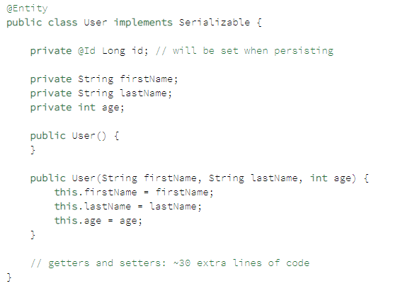
Getters/Setters, Constructors
Let's consider this class we want to use as a JPA entity as an example:

Slide 8
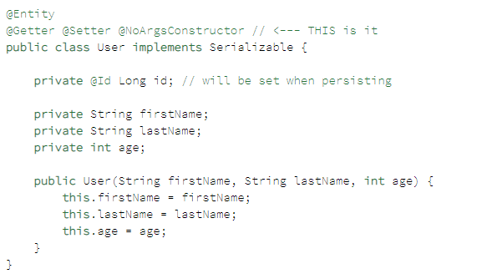
Getters/Setters, Constructors
Let us now Lombok-ize this class:

Slide 9
Getters/Setters, Constructors
What if you wanted to refine the visibility of some properties? For example, I like to keep my entities' id field modifiers package or protected visible because they are expected to be read but not explicitly set by application code. Just use a finer grained @Setter for this particular field:

Slide 10
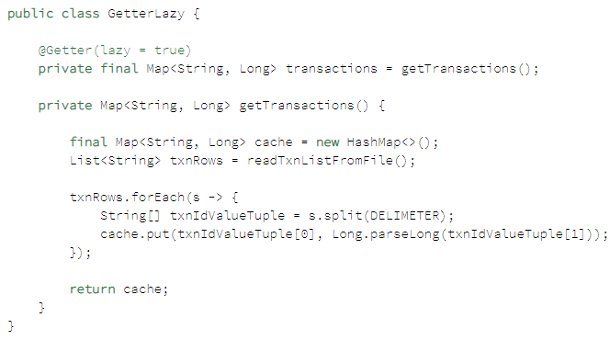
Lazy Getter
For instance, let's say we need to read static data from a file or a database. It's generally a good practice to retrieve this data once and then cache it to allow in-memory reads within the application. This saves the application from repeating the expensive operation.
Another common pattern is to retrieve this data only when it's first needed. In other words, only get the data when the corresponding getter is called the first time. This is called lazy-loading.

Slide 11
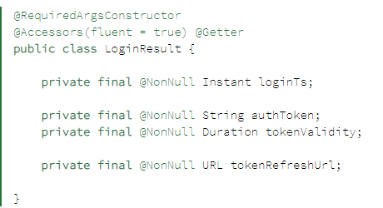
Value Classes/DTO's
Just add the @RequiredArgsConstructor annotation and you'd get a constructor for all the final fields int the class, just as you declared them. Adding @NonNull to attributes makes our constructor check for nullability and throw NullPointerExceptions accordingly. This would also happen if the fields were non-final and we added @Setter for them.
Don't you want boring old get*() form for your properties? Because we added @Accessors(fluent=true) in this example “getters” would have the same method name as the properties: getAuthToken() simply becomes authToken().

Slide 12
Core Java Boilerplate
We can automate this by means of other Lombok class-level annotations:
@ToString: will generate a toString() method including all class attributes. No need to write one ourselves and maintain it as we enrich our data model.
@EqualsAndHashCode: will generate both equals() and hashCode() methods by default considering all relevant fields, and according to very well though semantics.

Slide 13
Core Java Boilerplate
We wouldn't like to have the whole list of events dumped whenever we call the toString() method of our User, just because we used the @ToString annotation. No problem: just parameterize it like this: @ToString(exclude = {“events”}), and that won't happen. This is also helpful to avoid circular references if, for example, UserEvents had a reference to a User.
For the LoginResult example, we may want to define equality and hash code calculation just in terms of the token itself and not the other final attributes in our class. Then, simply write something like @EqualsAndHashCode(of = {“authToken”}).
Bonus: if you liked the features from the annotations we've reviewed so far you may want to examine @Data and @Value annotations as they behave as if a set of them had been applied to our classes. After all, these discussed usages are very commonly put together in many cases.

Slide 14
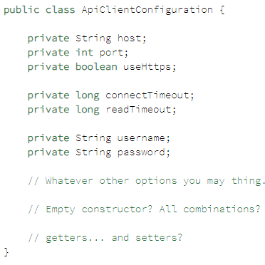
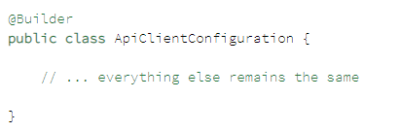
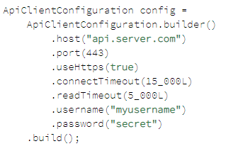
The Builder Pattern

Slide 15
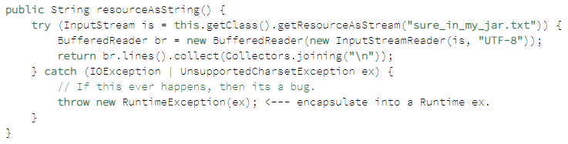
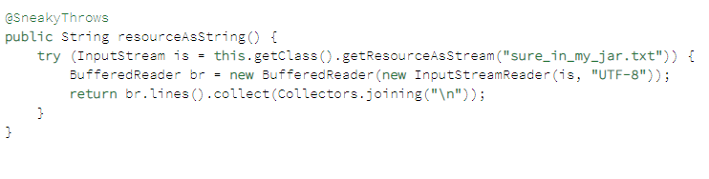
Checked Exceptions Burden
Lots of Java APIs are designed so that they can throw a number of checked exceptions client code is forced to either catch or declare to throws. How many times have you turned these exceptions you know won't happen into something like this?

Slide 16
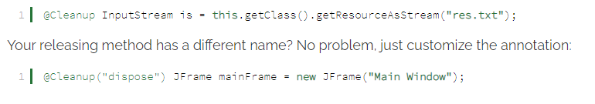
Ensure Your Resources Are Released
Java 7 introduced the try-with-resources block to ensure your resources held by instances of anything implementing java.lang.AutoCloseable are released when exiting.
Lombok provides an alternative way of achieving this, and more flexibly via @Cleanup. Use it for any local variable whose resources you want to make sure are released. No need for them to implement any particular interface, you'll just get its close() method called.

Slide 17
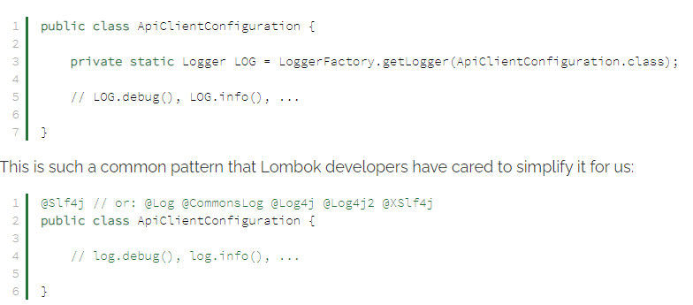
Annotate Your Class to Get a Logger

Slide 18

Write Thread-Safer Methods
In Java you can use the synchronized keyword to implement critical sections. However, this is not a 100% safe approach: other client code can eventually also synchronize on your instance, potentially leading to unexpected deadlocks.
This is where @Synchronized comes in: annotate your methods (both instance and static) with it and you'll get an autogenerated private, unexposed field your implementation will use for locking:

Slide 19
Other annotations
@EqualsAndHashCode.Exclude
@EqualsAndHashCode.Include
@ToString.Exclude
@ToString.Include
@Data

Slide 20
Jetbrains IntelliJ IDEA
The Jetbrains IntelliJ IDEA editor is compatible with lombok.
Add the Lombok IntelliJ plugin to add lombok support for IntelliJ:
Go to File > Settings > Plugins
Click on Browse repositories...
Search for Lombok Plugin
Click on Install plugin
Restart IntelliJ IDEA

Slide 21
Links
https://projectlombok.org/api/lombok/package-summary.html
https://projectlombok.org/features/all
https://www.baeldung.com/intro-to-project-lombok

